Slide 1

ICMP Ping Client
Huang Hao, Zhou Yitong, Meng Yu, Chen Zijie, Wen Tianshu
2024.10.11

Slide 2
Introduction of ICMP
01 Preparation
目 录
Divide of tasks
02 Packet
CONTENTS
Send & Receive & delay calculation
03 Process
ICMP Type Handling
do one ping & ping
04 Test
Visualization
05 Conclusion
Version control

Slide 3
01
PART
Preparation

Slide 4






Prepare
traceroute
packet
test
conclusion
Introduction of ICMP

Slide 5
Prepare
traceroute
packet
test
conclusion
Division of tasks
关键点：点击此处修改标题点击此处修改标题点击此处修改标题点击此处修改标题点击此处修改标题
Huang Hao
Getting through the code framework
Concurrency control & RTT visualization
Windows & Linux testing
Meng Yu
Checksum calculation
ICMP packet management
Customize user input
Chen Zijie
send & receive function
delay calculation(min/max/avg)
Exception Handling Improvement
Zhou Yitong(presentor)
do one ping & ping
multi-threaded processing
Wen Tianshu
Functional testing with wireshark
Calculation of packet loss rate

Slide 6
02
PART
Packet construction

Slide 7


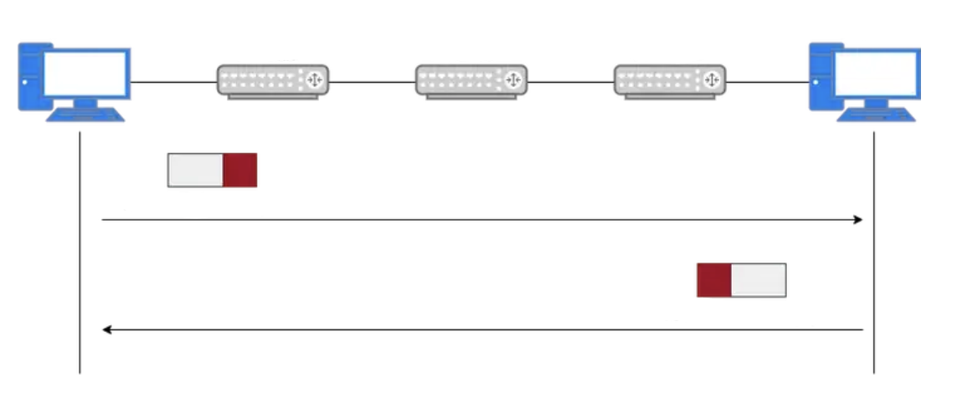
Prepare
traceroute
packet
test
conclusion
ICMP Packet Construction and Validation Process
calculate_checksum Function
PC A
PC B
1. Calculates the checksum for an ICMP packet (used to verify data integrity).
2. Processes the data in 16-bit blocks (two bytes) and sums them up.
3. If the data length is odd, it pads with a zero byte for checksum calculation.
4. Carries any overflow bits from the most significant to the least significant.
5. Returns the one's complement of the sum (inverted bits), which becomes the packet's checksum for error checking.
Router A
Router B
Router C
ICMP Echo Request
create_icmp_packet Function
ICMP Echo Reply
1. Creates an ICMP packet to be sent in an Echo Request.
2. Assembles the ICMP header fields: type (8 for request), code (0), checksum (initially 0), packet ID, and sequence number.
3. Packs the header using struct.pack to convert the values into a binary format for transmission.
4. Calls calculate_checksum to compute the checksum over the combined header and user data.
5. Replaces the initial checksum with the correct value in the packed header.
6. Combines the header and user data into a complete packet.
7. Returns the full ICMP packet ready to be sent.
点击此处修改内容点击此处修改内容点击此处修改内容点击此处修改内容改内容

Slide 8
Prepare
traceroute
packet
test
conclusion
ICMP Packet Construction and Validation Process
calculate_checksum Function
PC A
PC B
1. Calculates the checksum for an ICMP packet (used to verify data integrity).
2. Processes the data in 16-bit blocks (two bytes) and sums them up.
3. If the data length is odd, it pads with a zero byte for checksum calculation.
4. Carries any overflow bits from the most significant to the least significant.
5. Returns the one's complement of the sum (inverted bits), which becomes the packet's checksum for error checking.
Router A
Router B
Router C
ICMP Echo Request
create_icmp_packet Function
ICMP Echo Reply
1. Creates an ICMP packet to be sent in an Echo Request.
2. Assembles the ICMP header fields: type (8 for request), code (0), checksum (initially 0), packet ID, and sequence number.
3. Packs the header using struct.pack to convert the values into a binary format for transmission.
4. Calls calculate_checksum to compute the checksum over the combined header and user data.
5. Replaces the initial checksum with the correct value in the packed header.
6. Combines the header and user data into a complete packet.
7. Returns the full ICMP packet ready to be sent.
点击此处修改内容点击此处修改内容点击此处修改内容点击此处修改内容改内容

Slide 9
03
PART
Process of ICMP

Slide 10

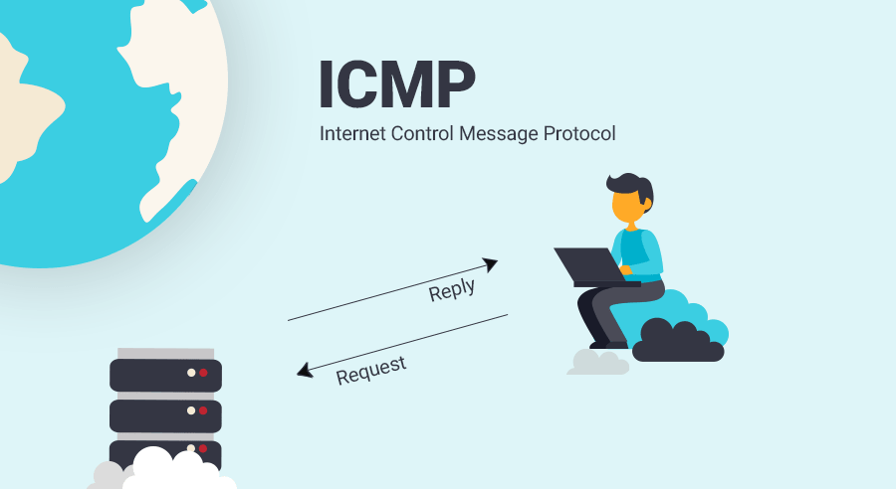
Prepare
traceroute
packet
test
conclusion
ICMP Transmission Process
send_one_ping Function
1. Sends an ICMP Echo Request packet.
2. Uses the created socket, target IP address, packet ID, and user data.
3. Creates an ICMP packet with create_icmp_packet containing ICMP header and user data.
4. Records the sending timestamp to calculate round-trip time later.
5. Sends the packet using sendto; port is set to 1 since ICMP does not use traditional ports.
6. Returns the timestamp for further processing.
SOCKET
receive_one_ping Function
点击此处修改内容点击此处修改内容点击此处修改内容点击此处修改内容改内容
1. Receives the ICMP Echo Reply packet and calculates round-trip time.
2. Sets socket timeout to avoid indefinite waiting.
3. Validates packet length to ensure it contains both IP and ICMP headers.
4. Parses ICMP header fields (type, code, checksum, ID, sequence number).
5. Confirms the packet type as Echo Reply and matches ID to verify it's the correct response.
6. Verifies the consistency of user data and returns the round-trip time.

Slide 11
Prepare
traceroute
packet
test
conclusion
ICMP Transmission Process
send_one_ping Function
1. Sends an ICMP Echo Request packet.
2. Uses the created socket, target IP address, packet ID, and user data.
3. Creates an ICMP packet with create_icmp_packet containing ICMP header and user data.
4. Records the sending timestamp to calculate round-trip time later.
5. Sends the packet using sendto; port is set to 1 since ICMP does not use traditional ports.
6. Returns the timestamp for further processing.
SOCKET
receive_one_ping Function
点击此处修改内容点击此处修改内容点击此处修改内容点击此处修改内容改内容
1. Receives the ICMP Echo Reply packet and calculates round-trip time.
2. Sets socket timeout to avoid indefinite waiting.
3. Validates packet length to ensure it contains both IP and ICMP headers.
4. Parses ICMP header fields (type, code, checksum, ID, sequence number).
5. Confirms the packet type as Echo Reply and matches ID to verify it's the correct response.
6. Verifies the consistency of user data and returns the round-trip time.

Slide 12
Prepare
traceroute
packet
test
conclusion
ICMP Transmission Process
send_one_ping Function
1. Sends an ICMP Echo Request packet.
2. Uses the created socket, target IP address, packet ID, and user data.
3. Creates an ICMP packet with create_icmp_packet containing ICMP header and user data.
4. Records the sending timestamp to calculate round-trip time later.
5. Sends the packet using sendto; port is set to 1 since ICMP does not use traditional ports.
6. Returns the timestamp for further processing.
SOCKET
receive_one_ping Function
点击此处修改内容点击此处修改内容点击此处修改内容点击此处修改内容改内容
1. Receives the ICMP Echo Reply packet and calculates round-trip time.
2. Sets socket timeout to avoid indefinite waiting.
3. Validates packet length to ensure it contains both IP and ICMP headers.
4. Parses ICMP header fields (type, code, checksum, ID, sequence number).
5. Confirms the packet type as Echo Reply and matches ID to verify it's the correct response.
6. Verifies the consistency of user data and returns the round-trip time.

Slide 13
04
PART
Testing

Slide 14

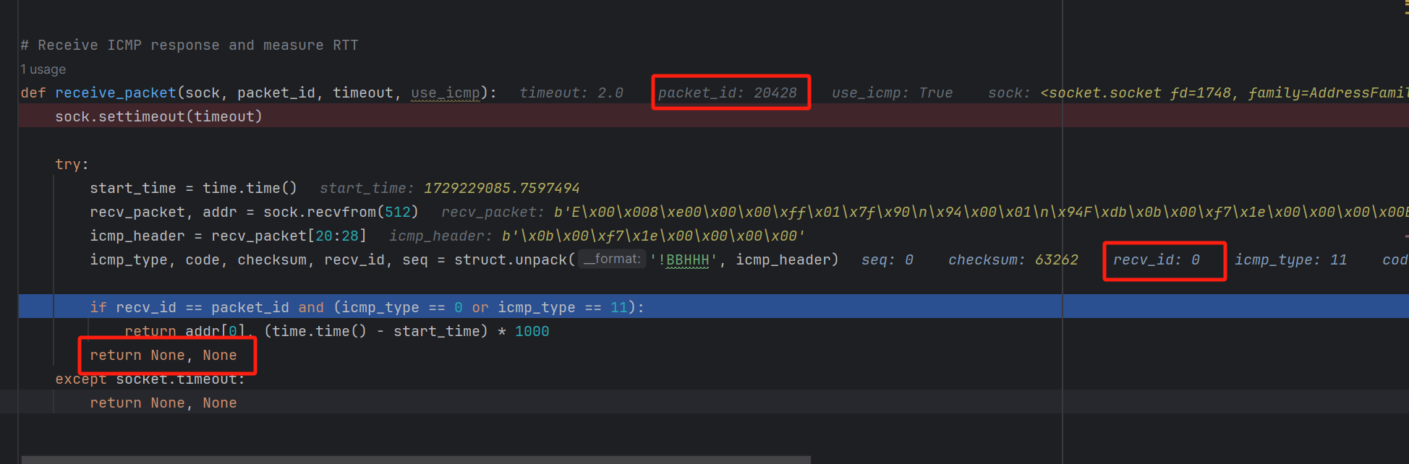
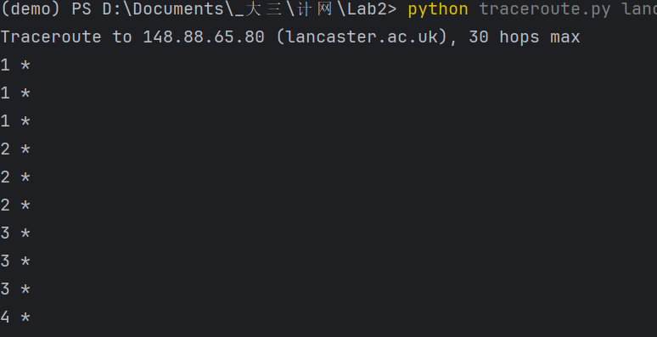
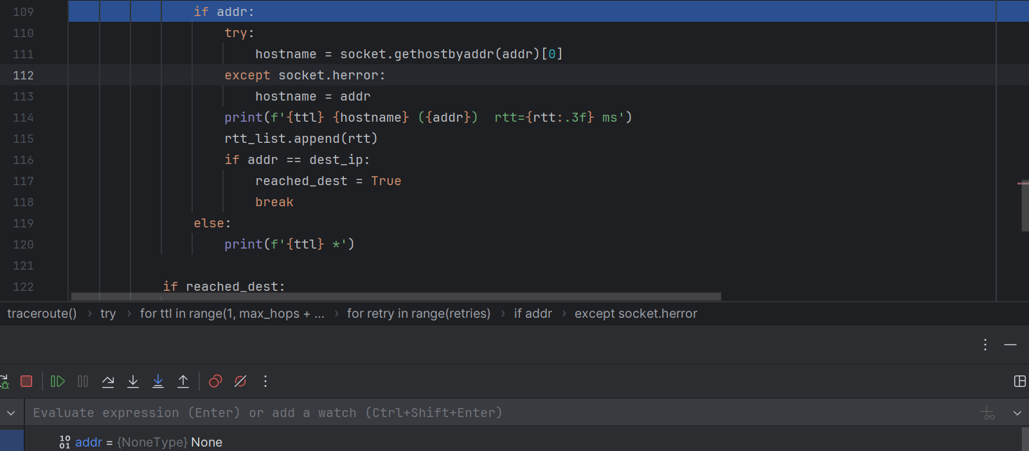
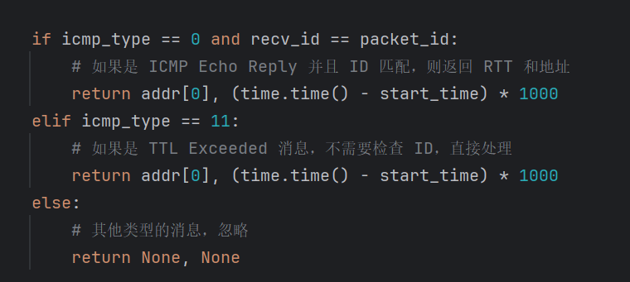
introduction
traceroute
packet
test
conclusion
Multiple problems have been solved
1. addr is None:
:
Possible Solution:
当TTL exceed时，不需要严格判断packet_id == recv_id

Slide 15
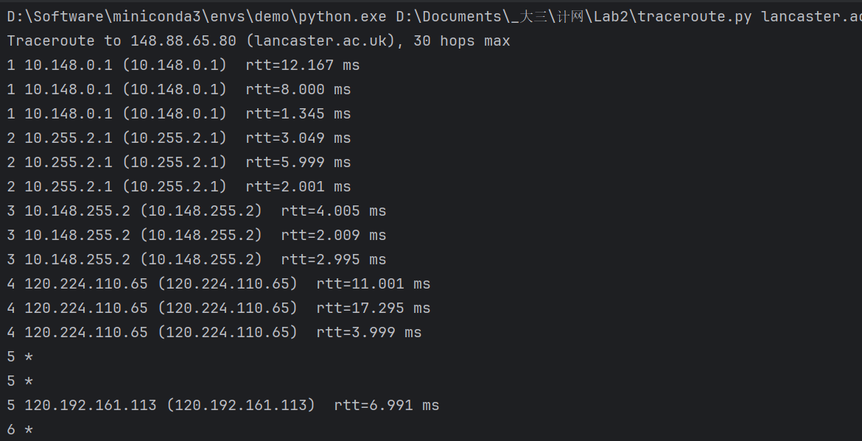
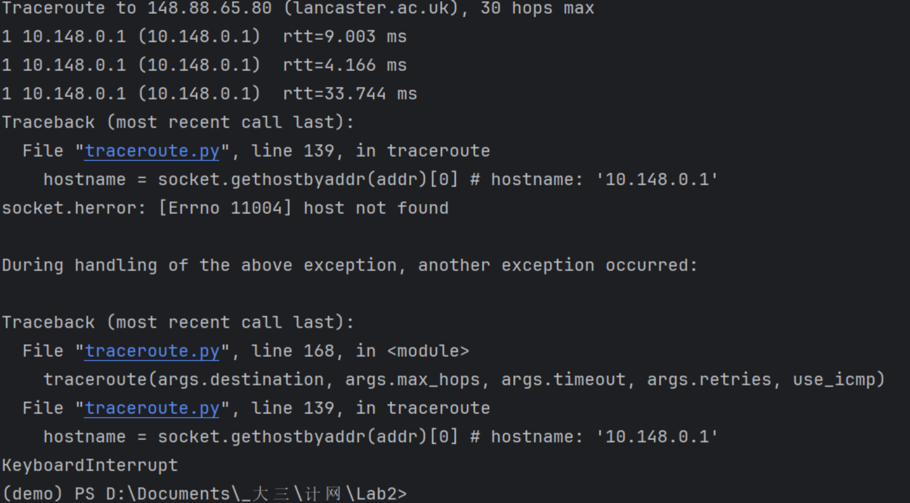
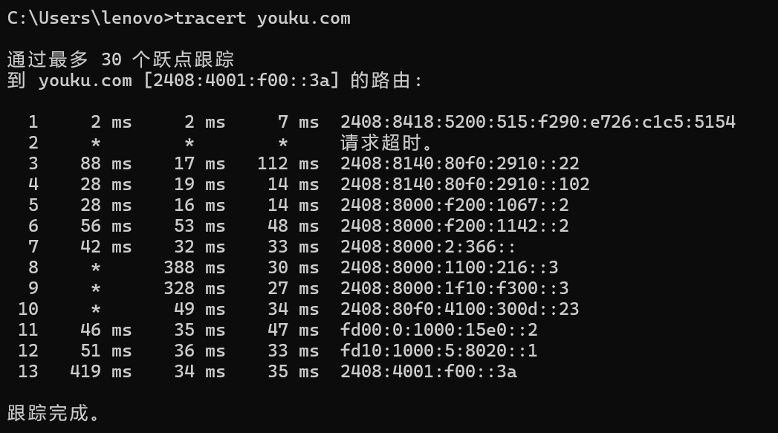
introduction
traceroute
packet
test
conclusion
Multiple problems have been solved
2. Network problem:
Should close the proxy
本地traceroute 也可能超时

Slide 16
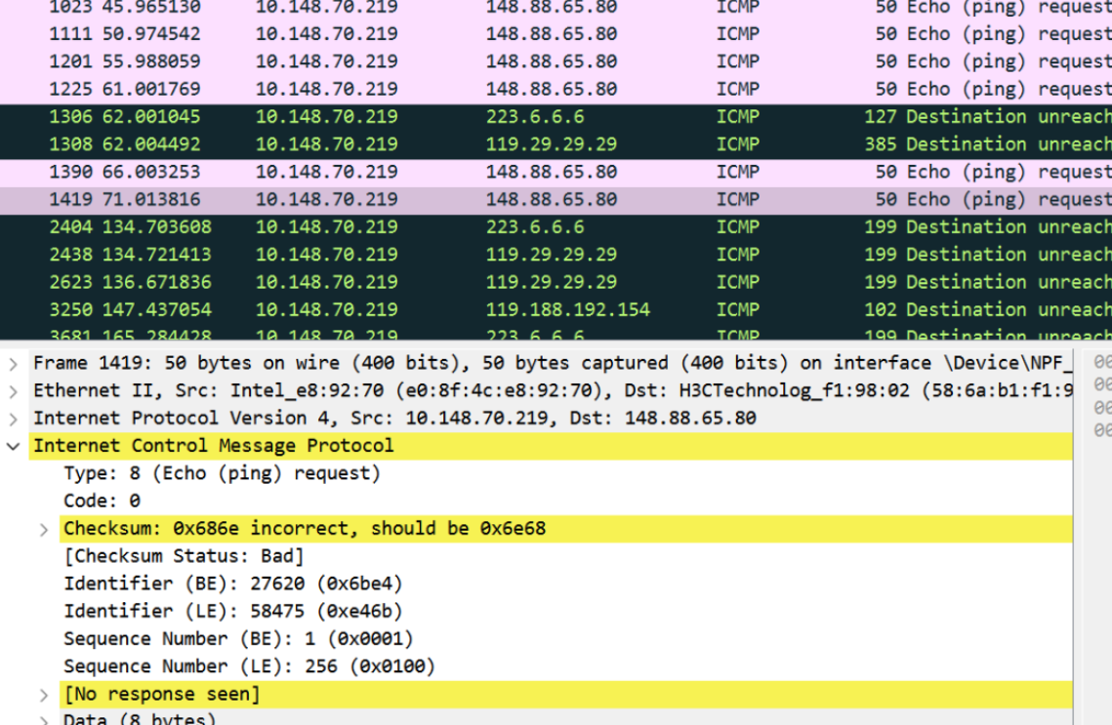
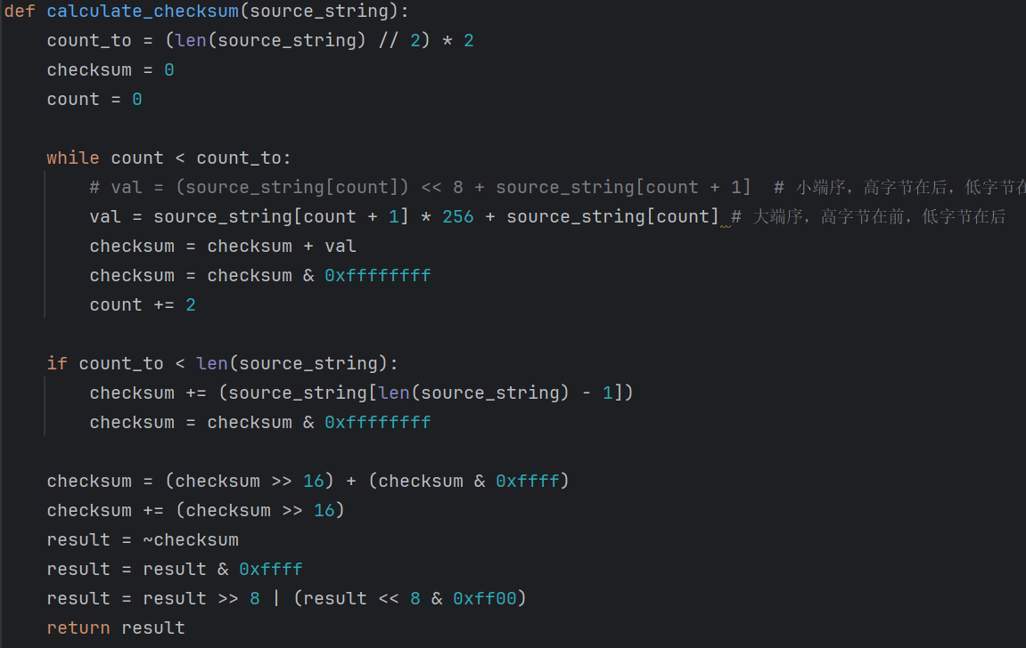
introduction
traceroute
packet
test
conclusion
Multiple problems have been solved
3. Incorrected checksum:
Possible Solution:
切换为大端序

Slide 17
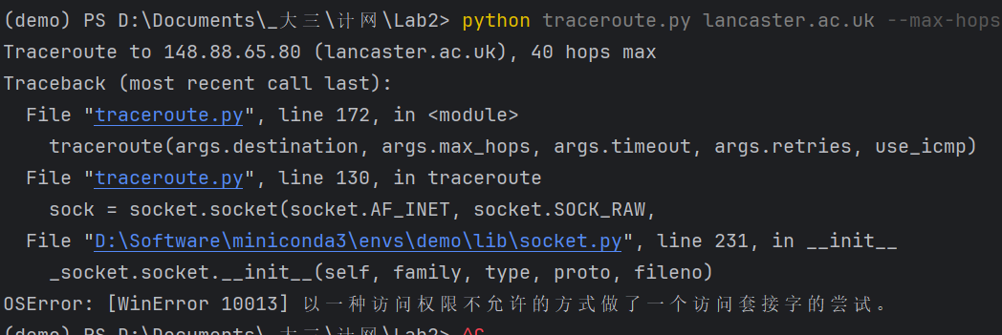
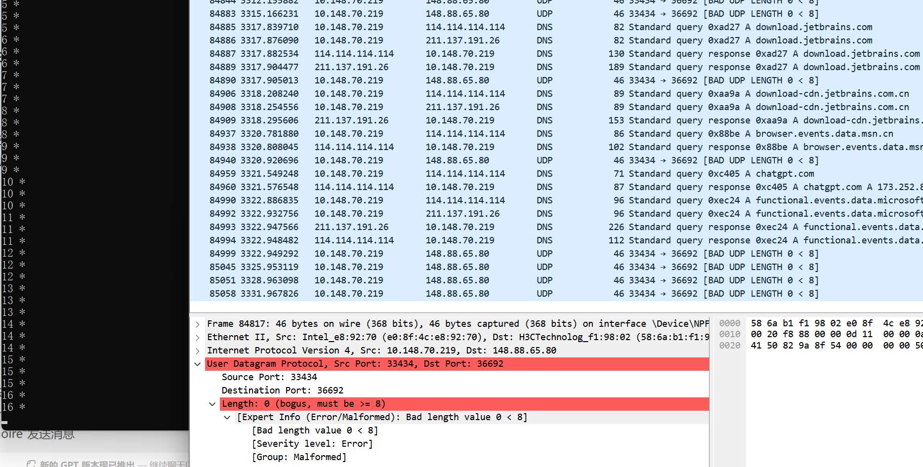
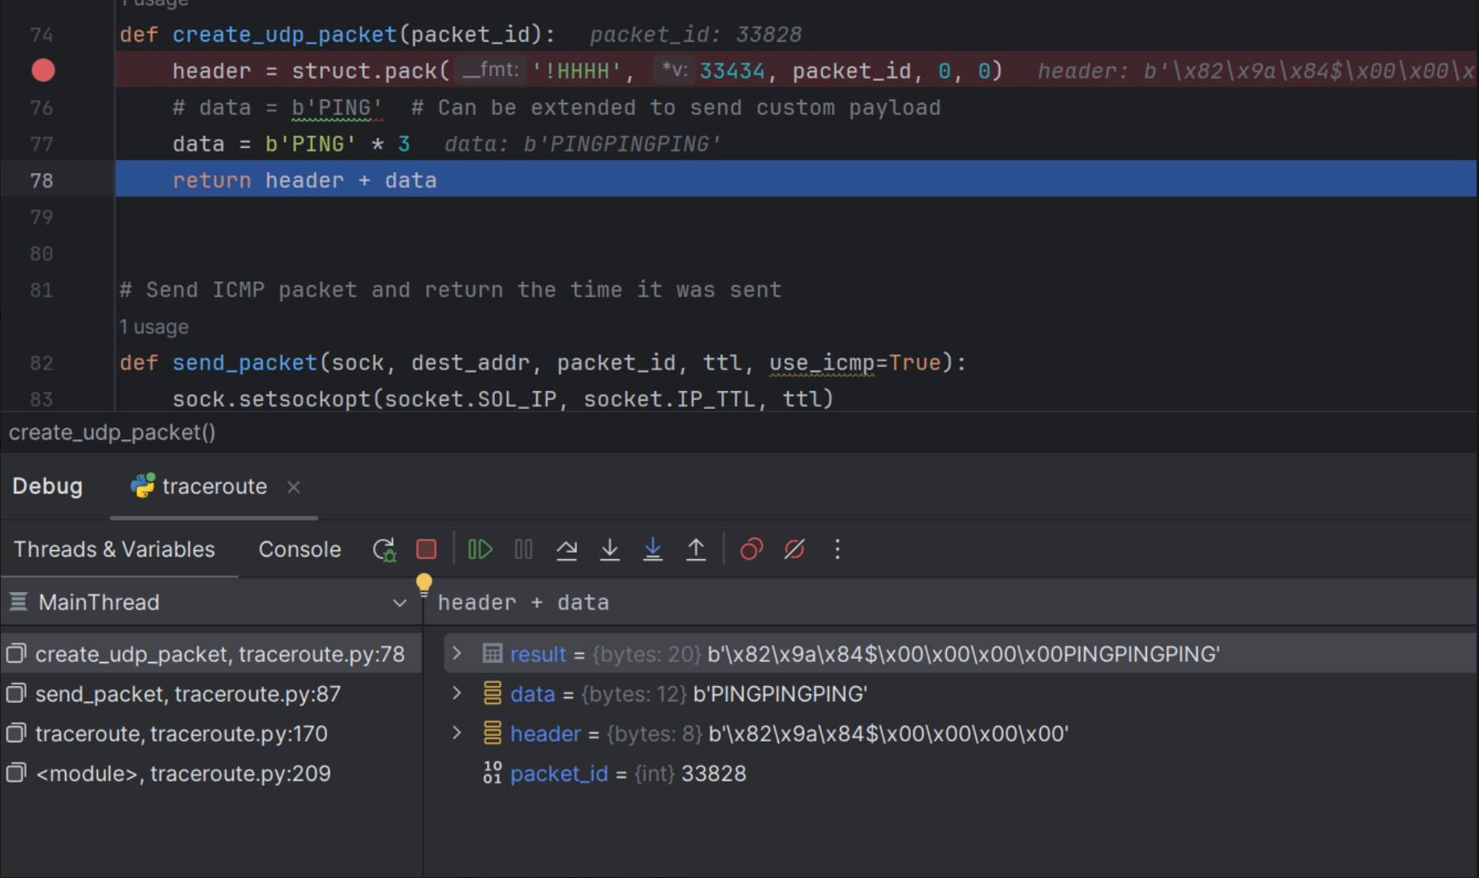
introduction
traceroute
packet
test
conclusion
Multiple problems have been solved
4. 无权限访问 & 数据包包长为 0 :
Possible Solution:
管理员身份运行

Slide 18
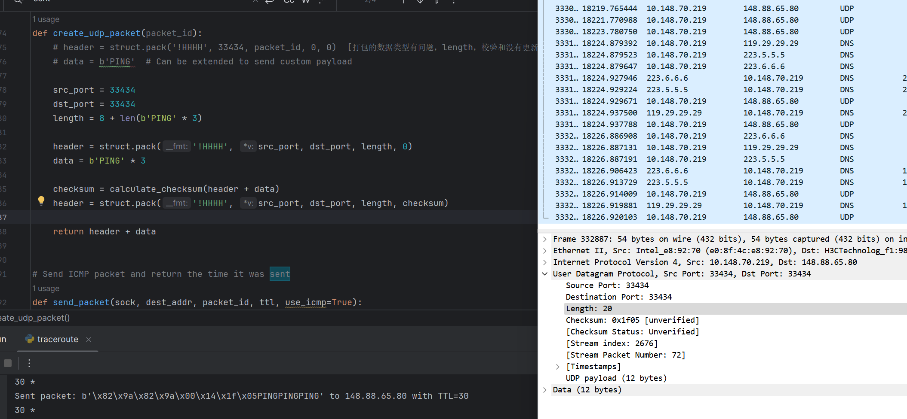
introduction
traceroute
packet
test
conclusion
Multiple problems have been solved
Solution:

Slide 19
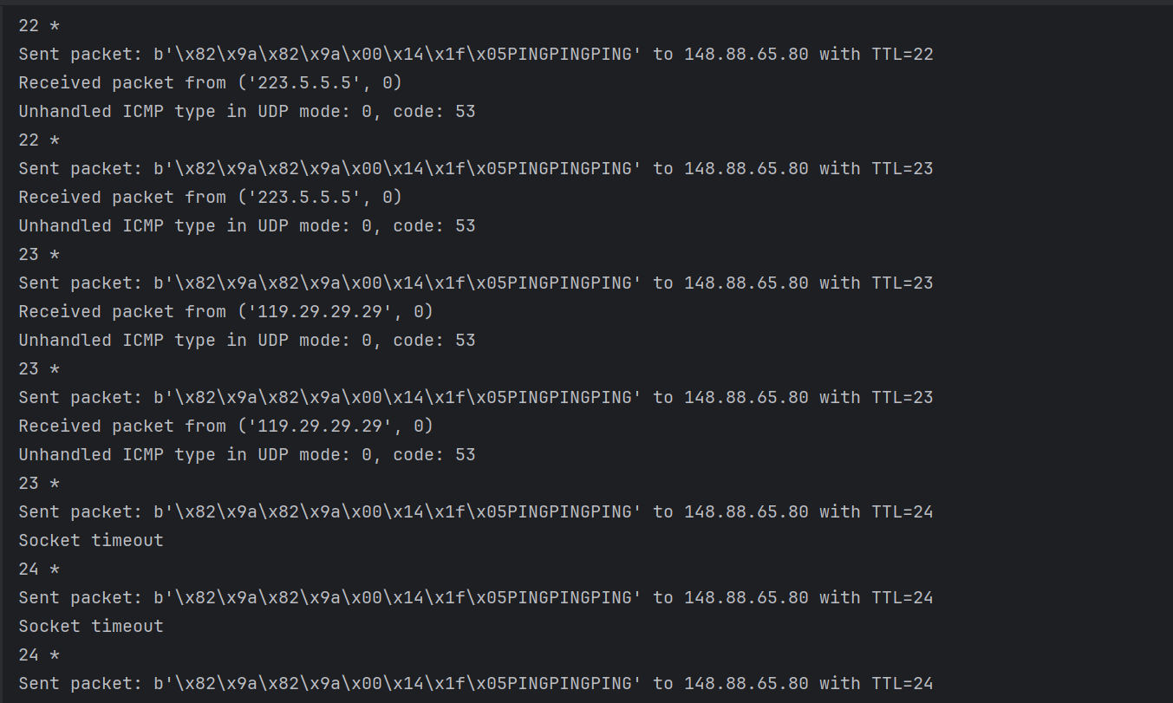
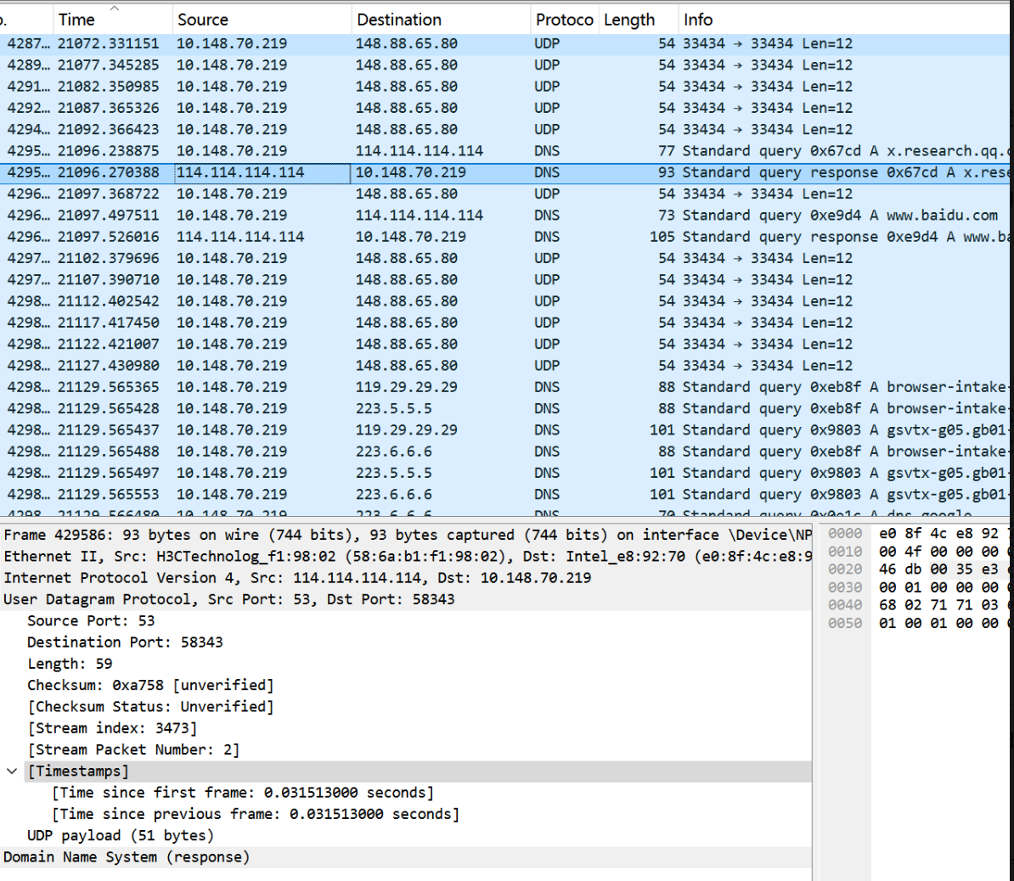

introduction
traceroute
packet
test
conclusion
Multiple problems have been solved
5. icmp_type=0, code=53 -> 返回包为 DNS 类型
UDP： icmp_type=0，code=53
socket timeout 是网络问题，取消代理

Slide 20
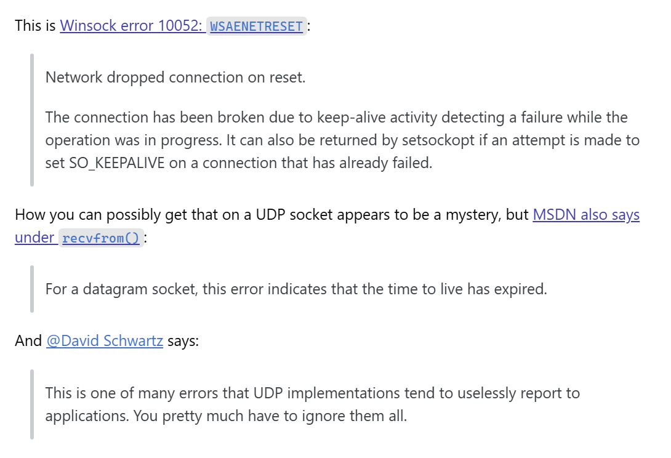
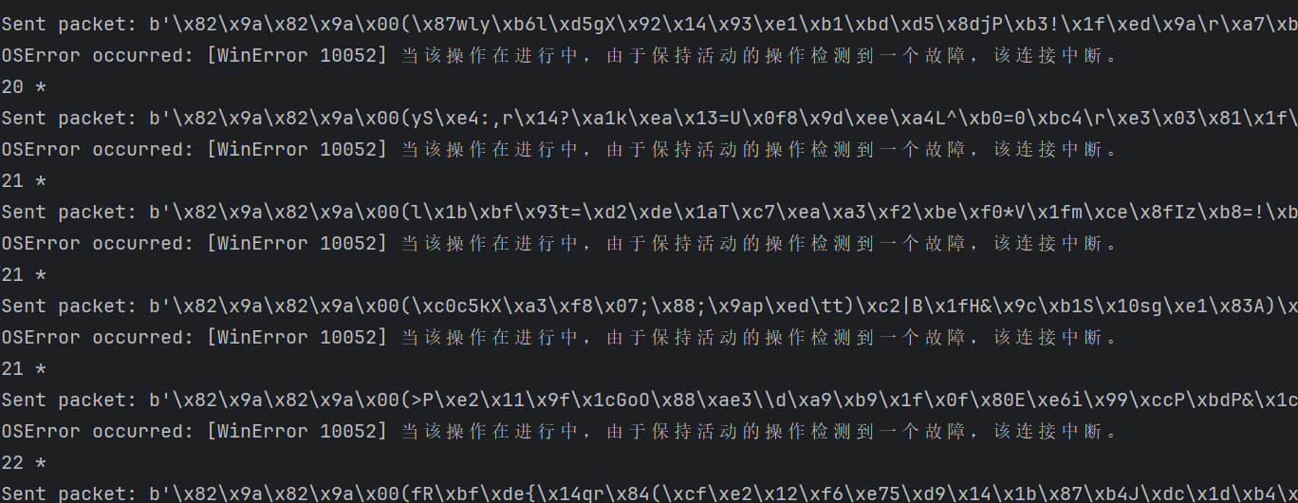
introduction
traceroute
packet
test
conclusion
Multiple problems have been solved
5. icmp_type=0, code=53 -> 返回包为 DNS 类型
Possible solution in community:
切换套接字：SOCK_RAW -> SOCK_DGRAM
Microsoft 开发文档：

Slide 21
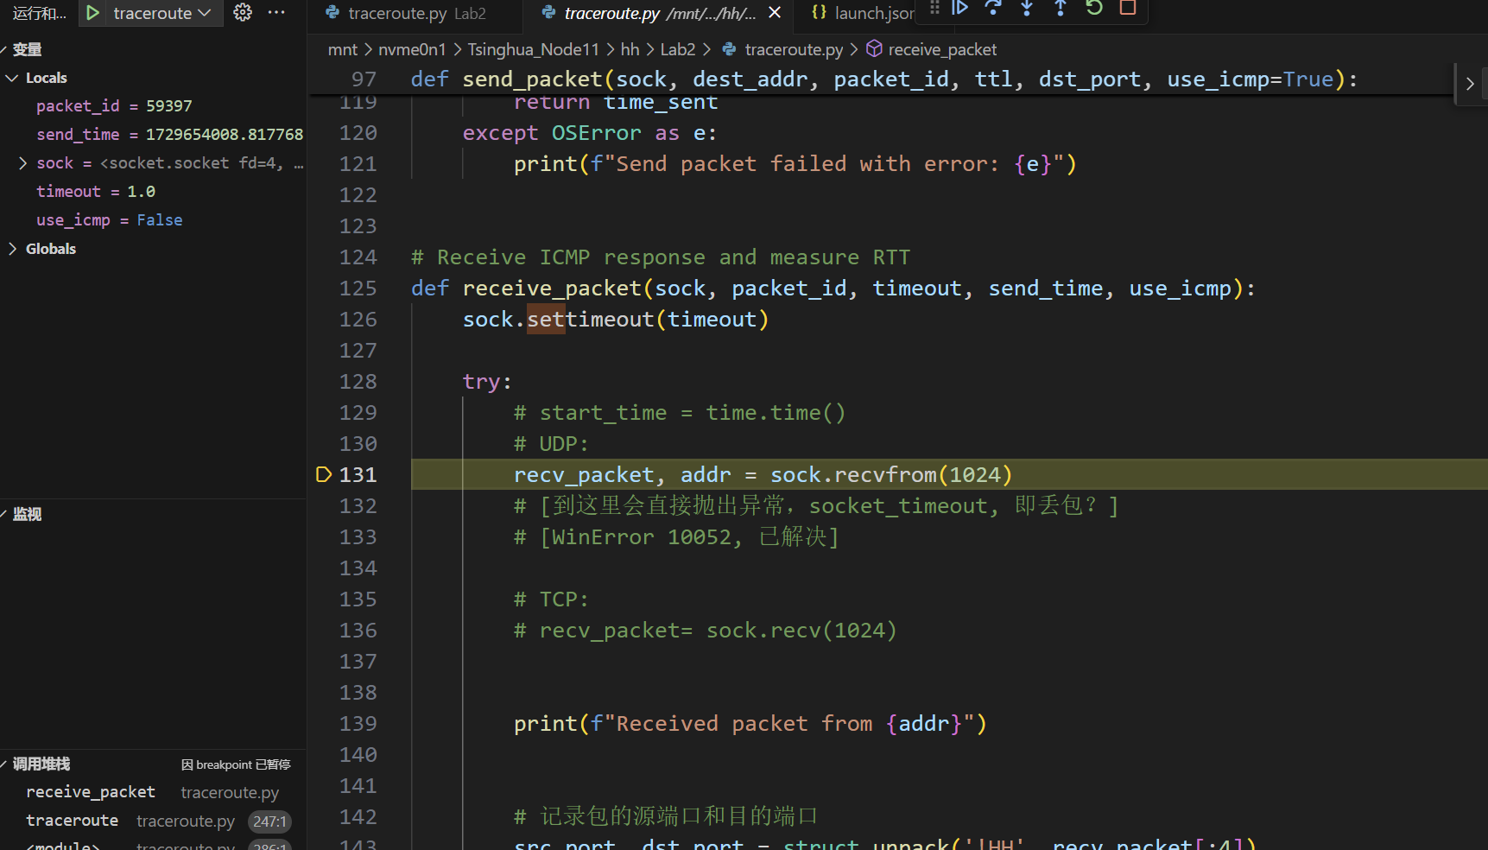
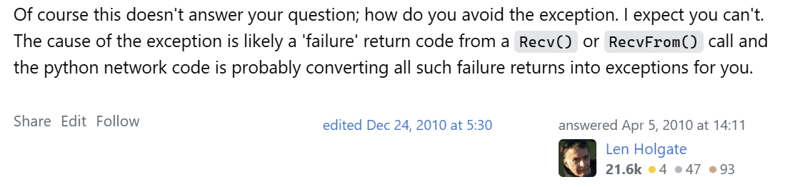
introduction
traceroute
packet
test
conclusion
Multiple problems have been solved
5. icmp_type=0, code=53 -> 返回包为 DNS 类型
切换OS：Windows -> Linux ()
New Error occured: WinError 10052 -> Socket timeout
Possible solution in community:
No solution!

Slide 22
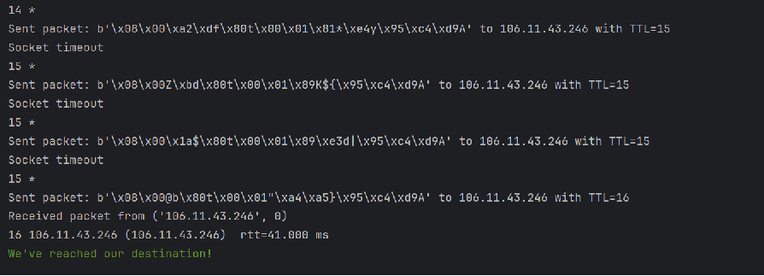
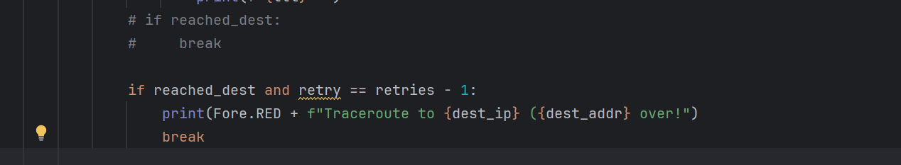
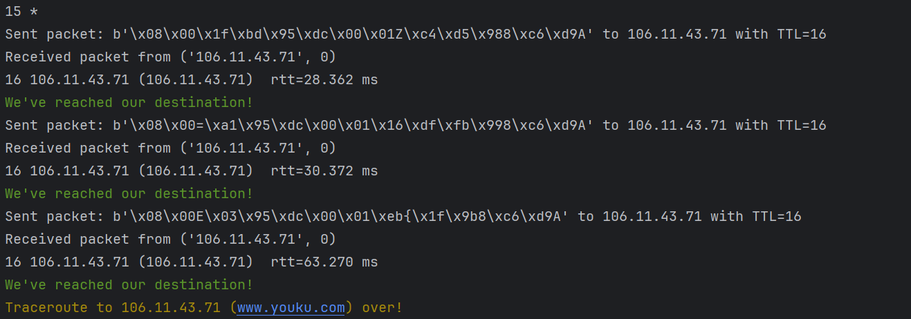
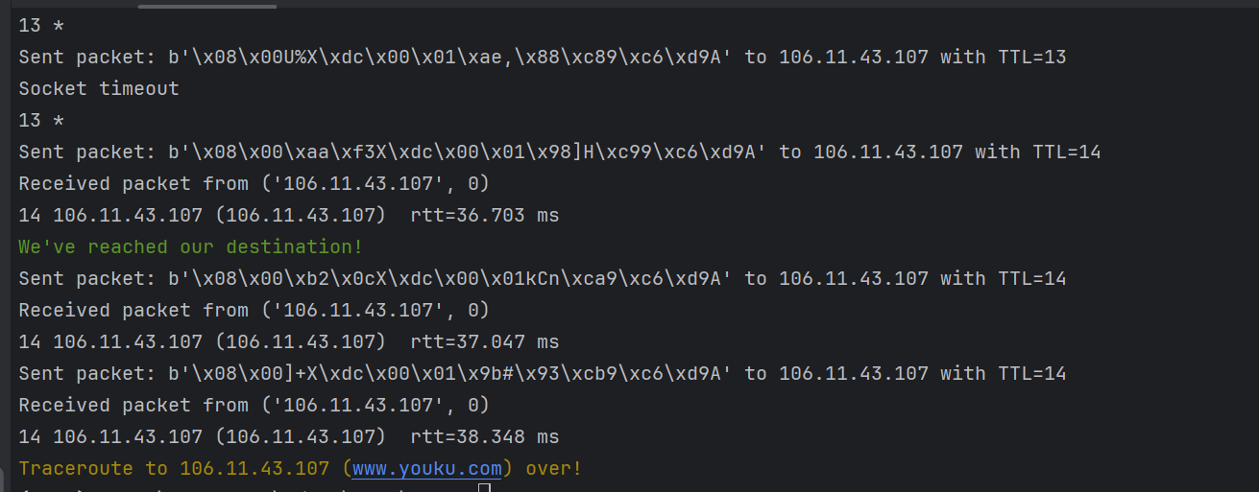
introduction
traceroute
packet
test
conclusion
Multiple problems have been solved
6. 到达目标主机后只返回一次TLL（不返回retries次）
Possible solution:
Add a new constraint condition:
成功返回了retries次TTL
But 重复打印“We’ve reached our destination”
Add a local stop flag:

Slide 23
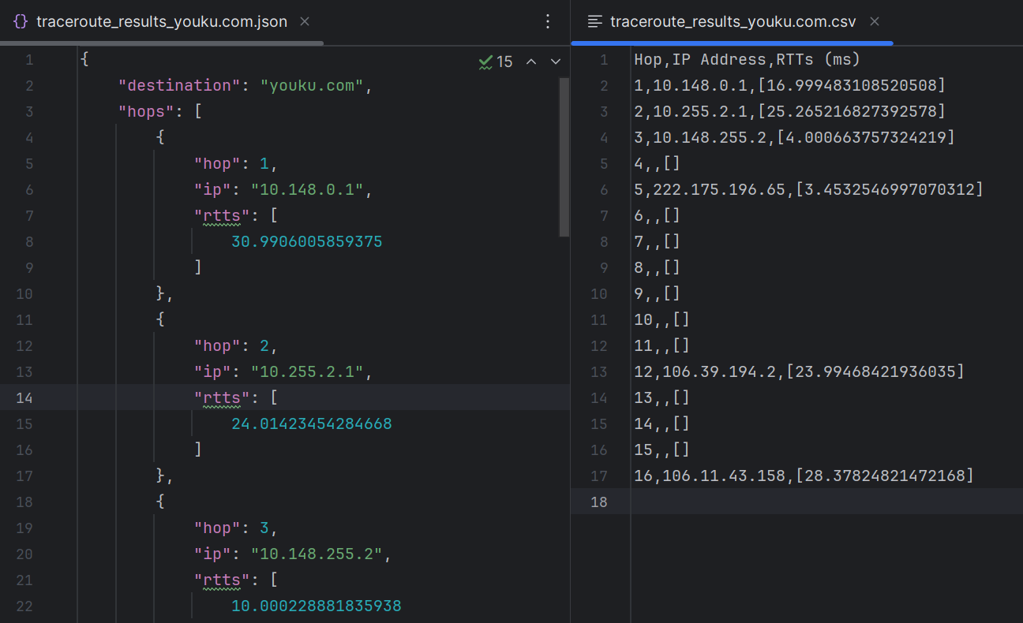
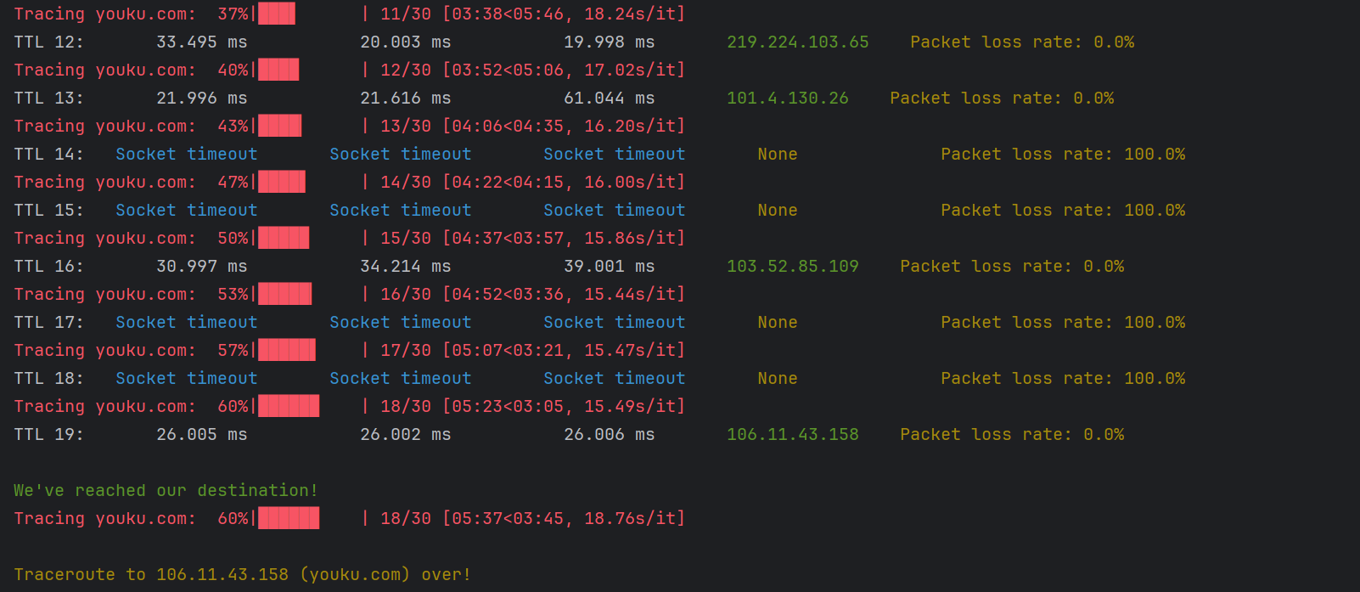
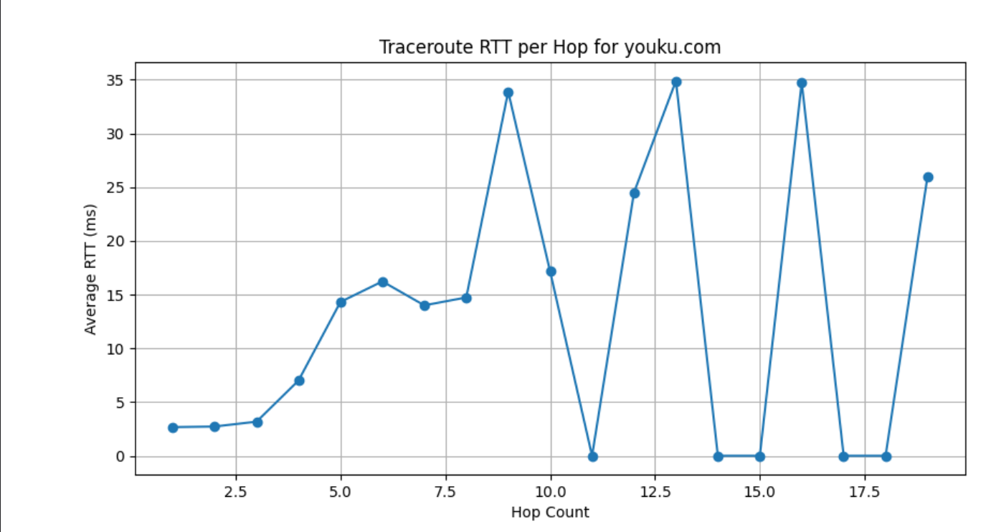
introduction
traceroute
packet
test
conclusion
Show the result
Using ICMP:
进度条显示，美化输出
存储路径信息：json / csv
RTT 可视化

Slide 24
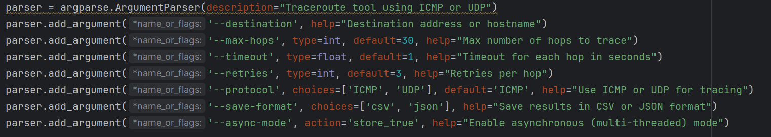
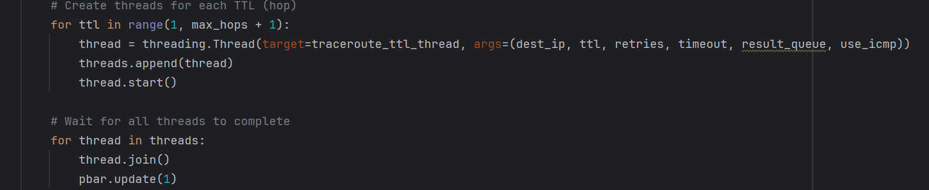
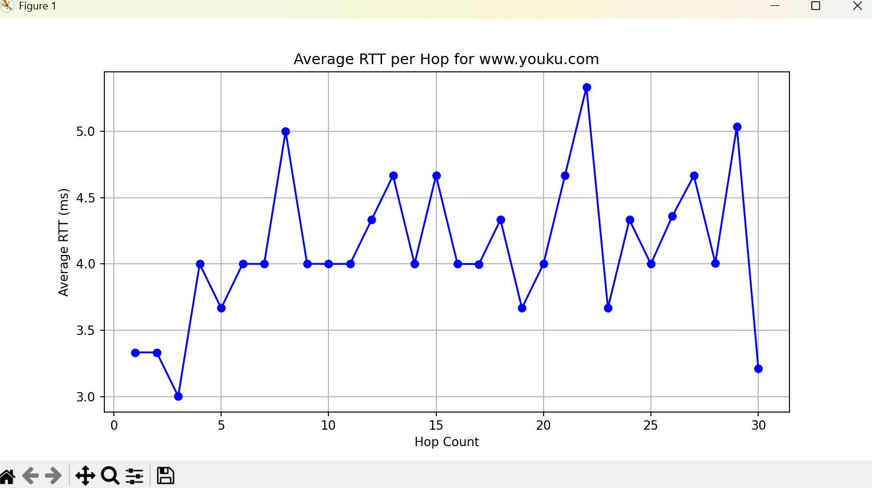
introduction
traceroute
packet
test
conclusion
Show the result
Using ICMP:
7个自定义参数
多线程异步：大幅提高traceroute的效率
Traceroute 用时： 337 s -> 1 s 内

Slide 25
05
PART
Conclusion

Slide 26

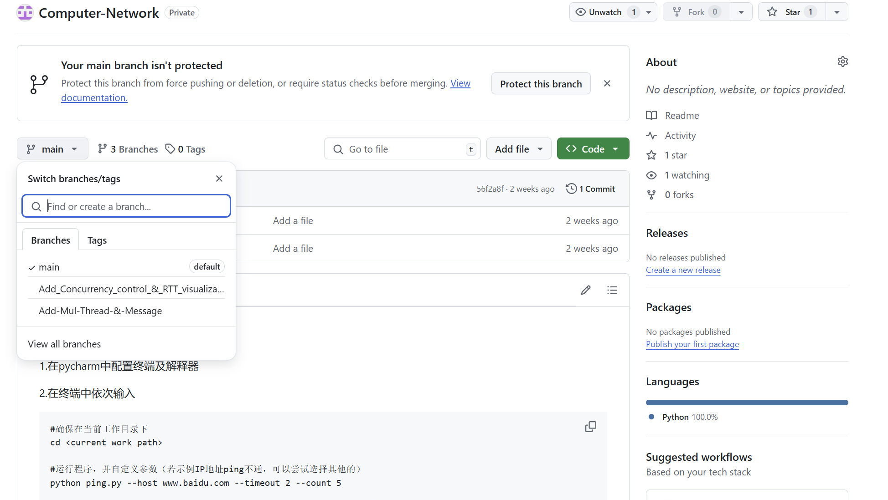
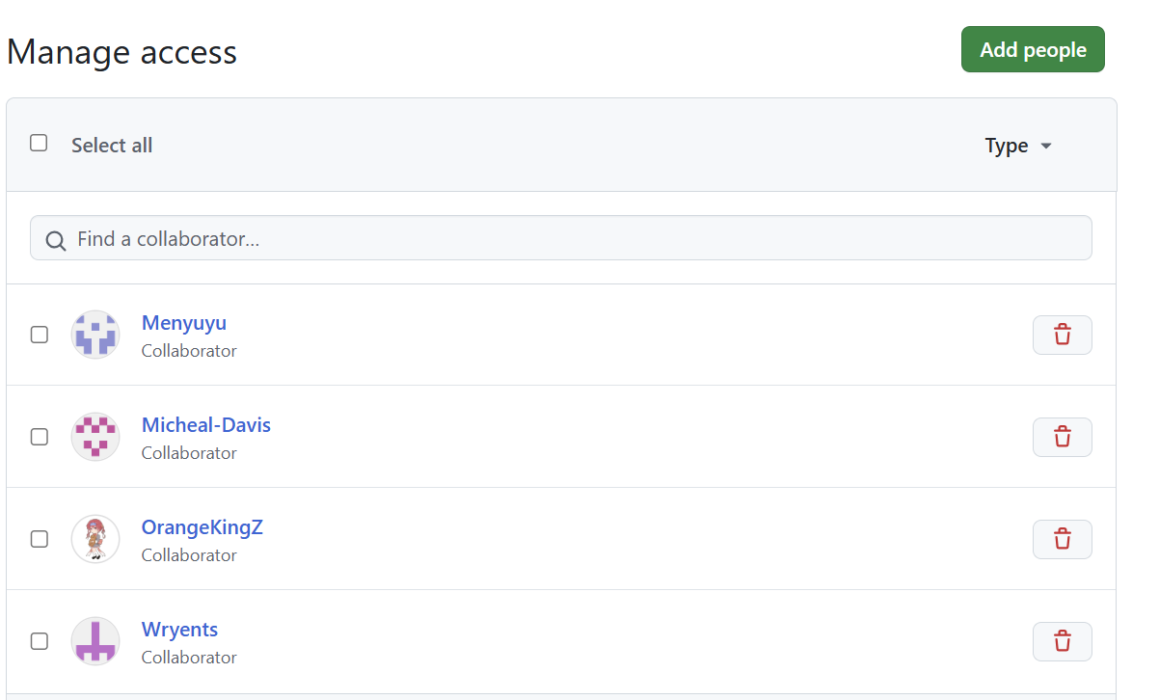
introduction
traceroute
packet
test
conclusion
Version control: Using Github
README.md
ping.py
.sh script
3 branches
5 collaborators

Slide 27
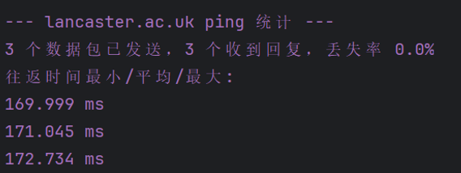
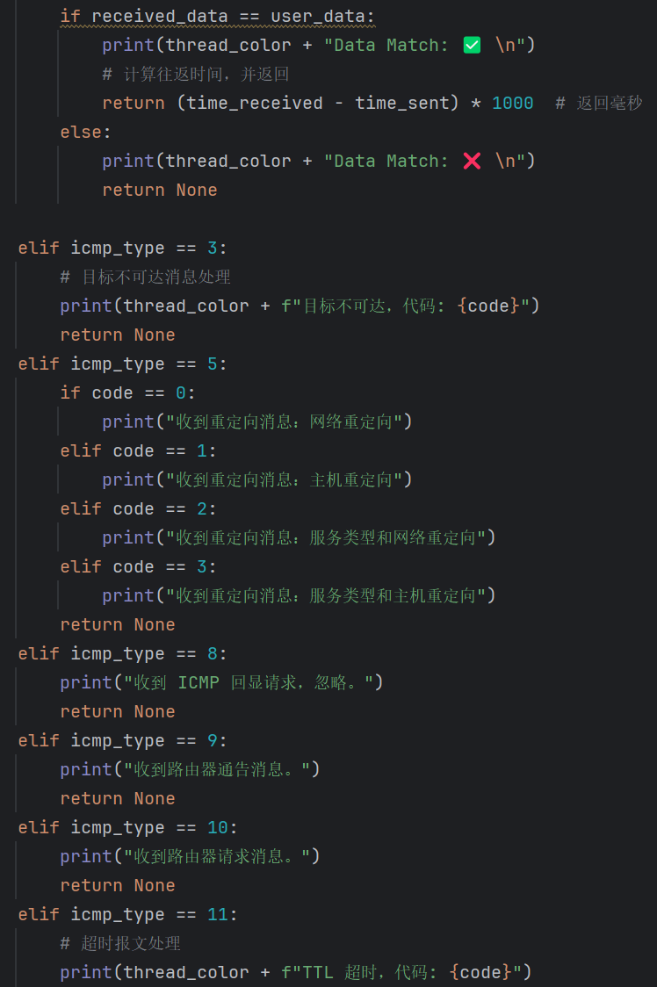
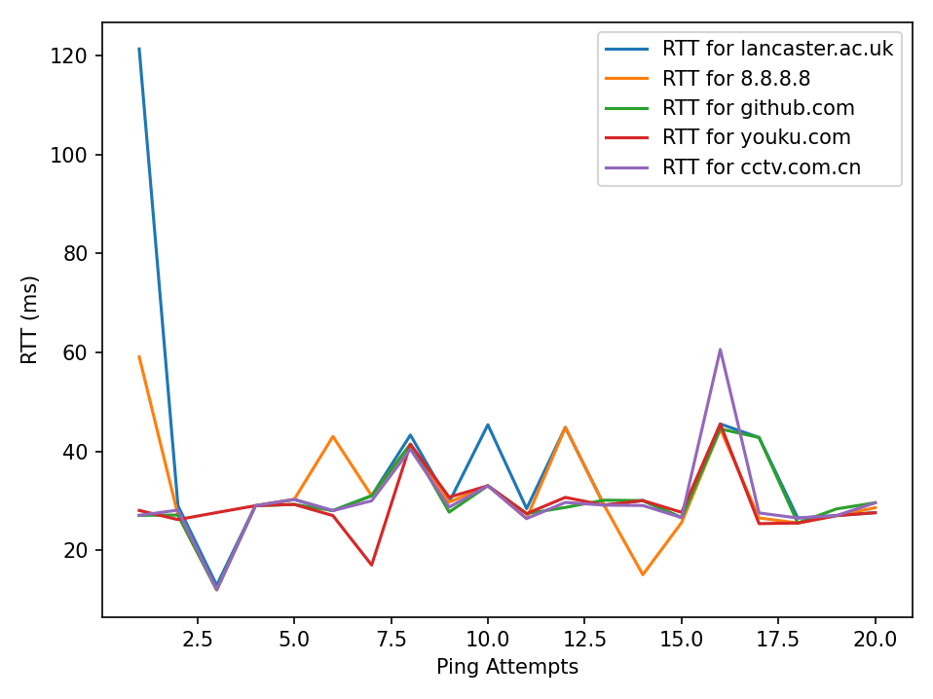
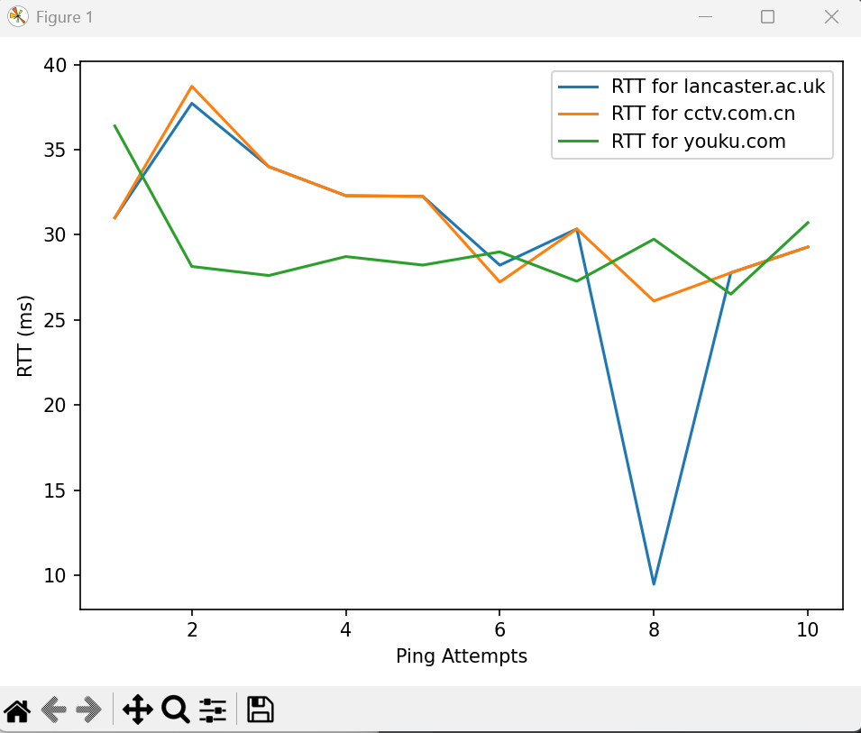
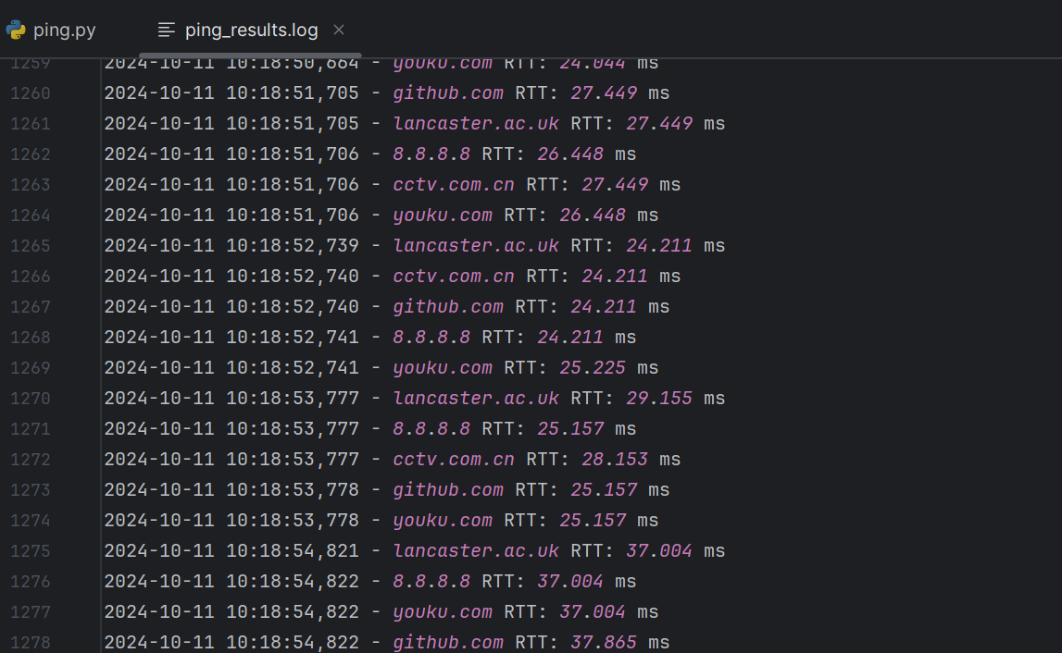
prepare
packet
process
test
conclusion
Summary of all functional implementations
Caculation of delay(min/max/avg)
Calculation of packet loss rate
20 kinds of exception handling
5 user input parameters
Customize packet sending content
Multithreading and concurrent processing
(Multi-destination ip management)
RTT visualization
log storage

Slide 28
Thank you!
Huang Hao, Zhou Yitong, Meng Yu, Chen Zijie, Wen Tianshu
2024.10.11

